Slide 1



Part 1
Reliable Transport Protocols

Slide 2
Transport Layer
Chapter goals:
understand principles behind transport layer services:
  multiplexing/demultiplexing
  reliable data transfer
  flow control
  congestion control
instantiation and implementation in the Internet
Chapter Overview:
transport layer services
multiplexing/demultiplexing
connectionless transport: UDP
principles of reliable data transfer
connection-oriented transport: TCP
  reliable transfer
  flow control
  connection management
principles of congestion control
TCP congestion control

Slide 3





Transport services and protocols
provide logical communication between app’ processes running on different hosts
implemented in end systems, but not in network routers
transport vs network layer services:
  network layer: data transfer between end systems
  transport layer: data transfer between processes
    relies on, enhances, network layer services
    Constrained by service model of Network-layer protocol
application
transport
network
data link
physical
network
data link
physical
network
data link
physical
network
data link
physical
logical end-end transport
network
data link
physical
network
data link
physical
application
transport
network
data link
physical
Let’s look at a simple analogy to see their subtle differences

Slide 4




Transport Layer vs. Network Layer
An Analogy: Cousins sending letters
East Coast
West Coast
Postal-service mail carrier
Uncle Sam
Uncle Bill
Uncle Sam & Uncle Bill - responsible for mail collection, distribution, and communicating with postal service
Postal service – carries the mails from house to house

Slide 5
Transport Layer vs. Network Layer
hosts (also called end systems) = ?
processes = ?
application messages = ?
network layer protocol = ?
transport layer protocol = ?

Slide 6
Transport Layer vs. Network Layer
Their services are constrained by the possible services that the postal service provides
hosts (also called end systems) = houses
processes = cousins
application messages = letters in envelope
transport layer protocol = Uncle Sam and Uncle Bill
network layer protocol = postal service (including mail persons)
It may so happen that their uncles could get sick, and so other people may take over – analogously, the computer network may provide multiple transport protocols

Slide 7
Transport Layer vs. Network Layer
Transport Layer
Network Layer
logical communication between processes
logical communication between end systems
moves messages from application process to the network layer and vice-versa: Sending & Receiving sides
computer network can make multiple transport layer protocols available
  TCP
  UDP
process-to-process communication
host-to-host communication

Slide 8
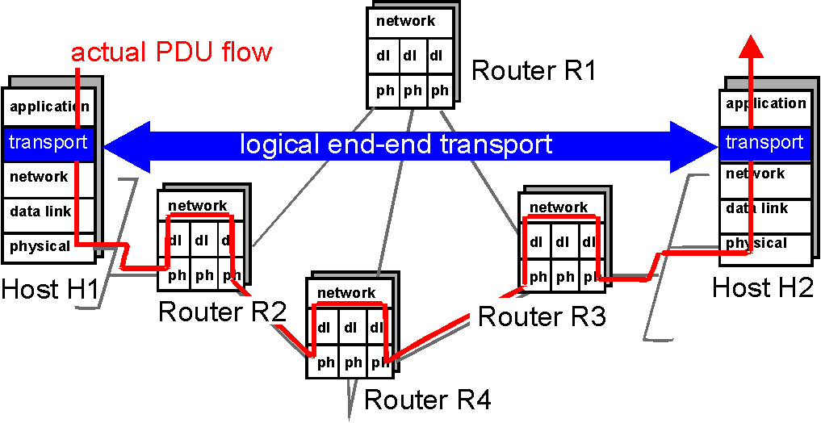
Logical Communication
sending
receiving
converts messages to 4-PDUs
receives 4-PDUs
Breaks down application messages into smaller chunks + transport layer header = 4-PDUs
removes transport header
reassembles the messages
passes to receiving application process
Network Layer: Each 4-PDU encapsulated into a 3-PDU

Slide 9
Transport-layer protocols
Internet transport services:
reliable, in-order unicast delivery (TCP)
  congestion
  flow control
  connection setup
unreliable (“best-effort”), unordered unicast or multicast delivery: UDP
services not available:
  real-time
  bandwidth guarantees
  reliable multicast
application
transport
network
data link
physical
network
data link
physical
network
data link
physical
network
data link
physical
logical end-end transport
network
data link
physical
network
data link
physical
application
transport
network
data link
physical
Critical Function: Extend IP’s service from host-to-host delivery to process-to-process delivery.
Notes:
Kurose book, p.440
Multicast – a multicast packet is delivered to only a subset of network nodes.
- packets from one or more senders are sent to a group of receivers

Slide 10
Multiplexing/demultiplexing
Recall: segment - unit of data exchanged between transport layer entities
  aka TPDU: transport protocol data unit
Demultiplexing: delivering
received segments to
correct app layer processes
receiver
P3
P4
application-layer
data
M
M
application
transport
network
segment
header
P1
P2
M
M
application
transport
network
application
transport
network
segment
H
t
M
H
segment
n

Slide 11
Multiplexing / demultiplexing
Multiplexing:
gathering data from multiple
app processes, enveloping
data with header (later used
for demultiplexing)
32 bits
source port #
dest port #
other header fields
multiplexing/demultiplexing:
based on sender, receiver port numbers, IP addresses
  source, dest port #s in each segment
  recall: well-known port numbers for specific applications
application
data
(message)
TCP/UDP segment format
Ports: 0-1023 are well-known and restricted, complete list: www.iana.org, RFC 3232

Slide 12


Multiplexing/demultiplexing: examples
source port: x
dest. port: 23
Web client
host C
host A
server B
source port:23
dest. port: x
Source IP: C
Dest IP: B
source port: y
dest. port: 80
Source IP: C
Dest IP: B
source port: x
dest. port: 80
port use: simple telnet app
Source IP: A
Dest IP: B
source port: x
dest. port: 80
Web
server B
Web client
host A
port use: Web server
How does a Web Server allow for multiple clients connecting to it at the same time if it’s using TCP?

Slide 13
UDP: User Datagram Protocol [RFC 768]
“no frills,” “bare bones” Internet transport protocol
“best effort” service, UDP segments may be:
  lost
  delivered out of order to app
connectionless:
  no handshaking between UDP sender, receiver
  each UDP segment handled independently of others
TCP – 20 bytes, UDP – 8 bytes
Why is there a UDP?
no connection establishment (which can add delay)
simple: no connection state at sender, receiver
small segment header
no congestion control: UDP can blast away as fast as desired
Additional functionalities are implemented by the application

Slide 14
UDP: more
For segment error checking
often used for streaming multimedia apps
  loss tolerant
  rate sensitive
other UDP uses (why?):
  DNS
  SNMP
reliable transfer over UDP: add reliability at application layer
  application-specific error recover!
32 bits
Length, in
bytes of UDP
segment,
including
header
source port #
dest port #
length
checksum
Application
data
(message)
UDP segment format
Notes:
SNMP – simple network management protocol

Slide 15
UDP checksum
Goal: detect “errors” (e.g., flipped bits) in transmitted segment
Sender:
treat segment contents as sequence of 16-bit integers
checksum: addition (1’s complement sum) of segment contents
sender puts checksum value into UDP checksum field
Receiver:
compute checksum of received segment
check if computed checksum equals checksum field value:
  NO - error detected
  YES - no error detected. But maybe errors nonetheless? More later ….

Slide 16
UDP checksum example:
Three packets of 16 bits each
  0110011001100110
  0101010101010101
  0000111100001111
adding the three, calling it ‘r’:
  1100101011001010
Send the four packets, the original three and 1’s complement of ‘r’ to destination
The 1’s complement of ‘r’ is:
  0011010100110101
at destination, the sum of four packets should be:
  1111111111111111
If the packet is damaged:
  1111101111111111 (zeros!!)
Why provide for error checking? No guarantee that it is provided in all of the links between source and destination

Slide 17


Slide 18

Principles of Reliable data transfer
important in application, transport and link layers
top-10 list of important networking topics!
characteristics of unreliable channel will determine complexity of reliable data transfer protocol (rdt)

Slide 19
Principles of Reliable data transfer
important in application, transport and link layers
top-10 list of important networking topics!
characteristics of unreliable channel will determine complexity of reliable data transfer protocol (rdt)

Slide 20

Reliable data transfer: getting started
rdt_send(): called from above, (e.g., by app.). Pass data to
deliver to receiver’s upper layer
deliver_data(): called by rdt to deliver data to upper layer
send
side
receive
side
udt_send(): called by rdt,
to transfer packet over
unreliable channel to receiver
rdt_rcv(): called when packet arrives on rcv-side of channel

Slide 21
Reliable data transfer: getting started
  We’ll:
  incrementally develop sender, receiver sides of reliable data transfer protocol (rdt)
  consider only unidirectional data transfer
    but control info will flow on both directions!
  use finite state machines (FSM) to specify sender, receiver
actions taken on state transition
  state: when in this “state” next state uniquely determined by next event
state
1
state
2
event
actions

Slide 22
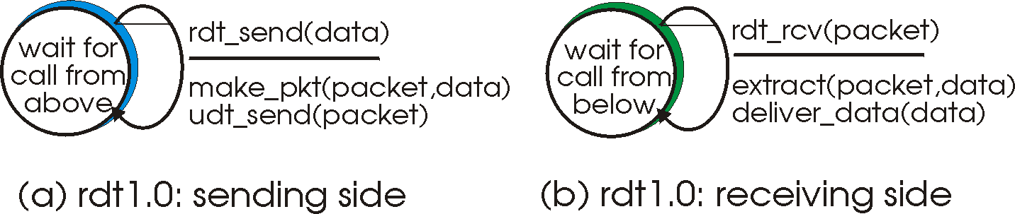
Rdt1.0: reliable transfer over a reliable channel
underlying channel perfectly reliable
  no bit errors
  no loss of packets
separate FSMs for sender, receiver:
  sender sends data into underlying channel
  receiver read data from underlying channel

Slide 23
Rdt2.0: channel with bit errors
Occurs during transmission, propagation and buffering
underlying channel may flip bits in packet
  recall: UDP checksum is used to detect bit errors
the question: how to recover from errors:
  acknowledgements (ACKs): receiver explicitly tells sender that pkt received OK
  negative acknowledgements (NAKs): receiver explicitly tells sender that pkt had errors
  sender retransmits pkt on receipt of NAK
  human scenarios: message dictation using ACKs, NAKs?
new mechanisms in rdt2.0 (beyond rdt1.0):
  error detection
  receiver feedback: control msgs (ACK,NAK) rcvr->sender
  retransmission

Slide 24
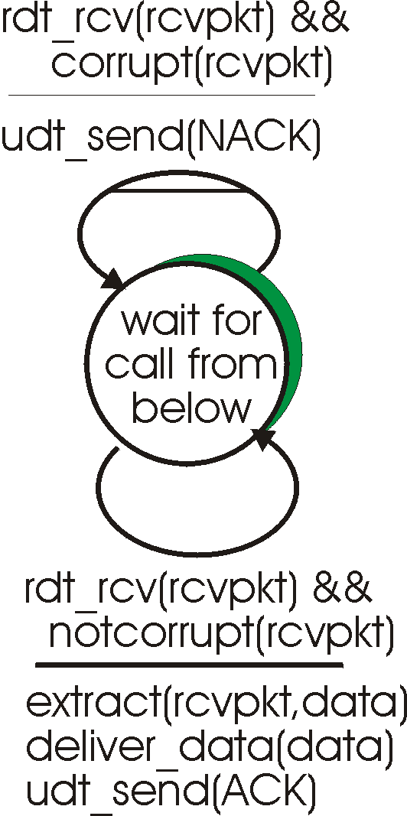
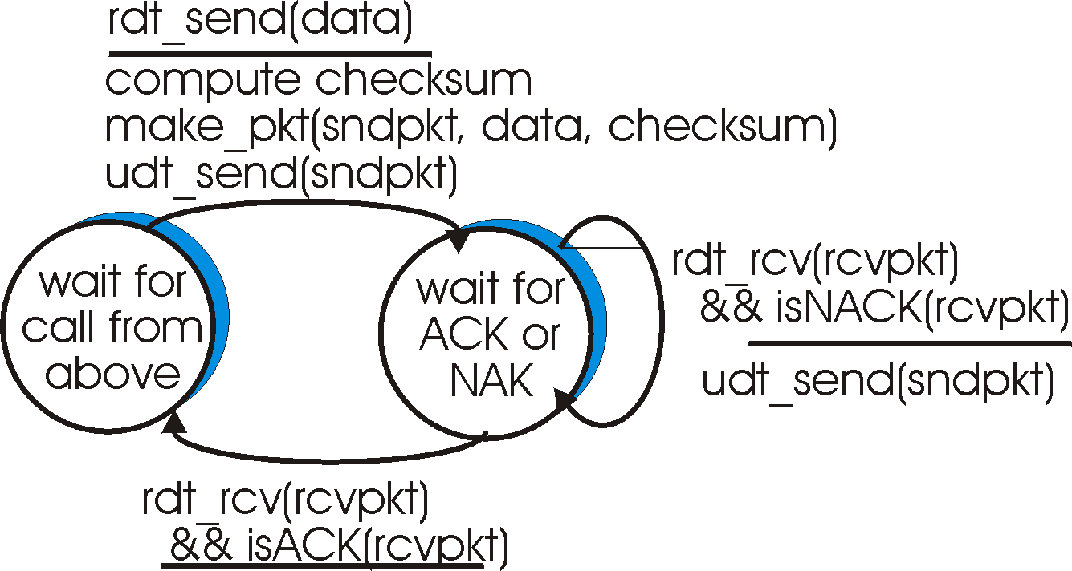
rdt2.0: FSM specification
sender FSM
receiver FSM

Slide 25
rdt2.0: in action (error scenario)
sender FSM
receiver FSM

Slide 26
rdt2.0 has a fatal flaw!
What happens if ACK/NAK gets corrupted?
sender doesn’t know what happened at receiver!
It can’t just retransmit: there’s a possibility of duplication
What to do?
sender ACKs/NAKs receiver’s ACK/NAK? However, what if the sender’s ACK/NAK gets lost?
retransmit, but this might cause retransmission of correctly received pkt!
Handling duplicates:
sender adds sequence number to each pkt
sender retransmits current pkt if ACK/NAK garbled
receiver discards (doesn’t deliver up) duplicate pkt
stop and wait protocol
Sender sends one packet,
then waits for receiver’s
response

Slide 27
rdt3.0: channels with bit errors and loss
Alternating bit Protocol
New assumption: underlying channel can also lose packets (data or ACKs)
  checksum, seq. #, ACKs, retransmissions will be of help, but not enough
Q: how to deal with loss?
  sender waits until certain data or ACK lost, then retransmits
  yuck: drawbacks?

Slide 28

rdt3.0 sender
Approach: sender waits for a “reasonable” amount of time for an ACK
retransmit if no ACK is received within this period
if pkt (or ACK) just delayed (not lost):
  retransmission would cause packet duplication, but use of seq. #’s already handles this
  receiver must specify seq # of pkt being ACKed
requires countdown timer
Put the burden of detecting and recovering from lost packets to the sender

Slide 29
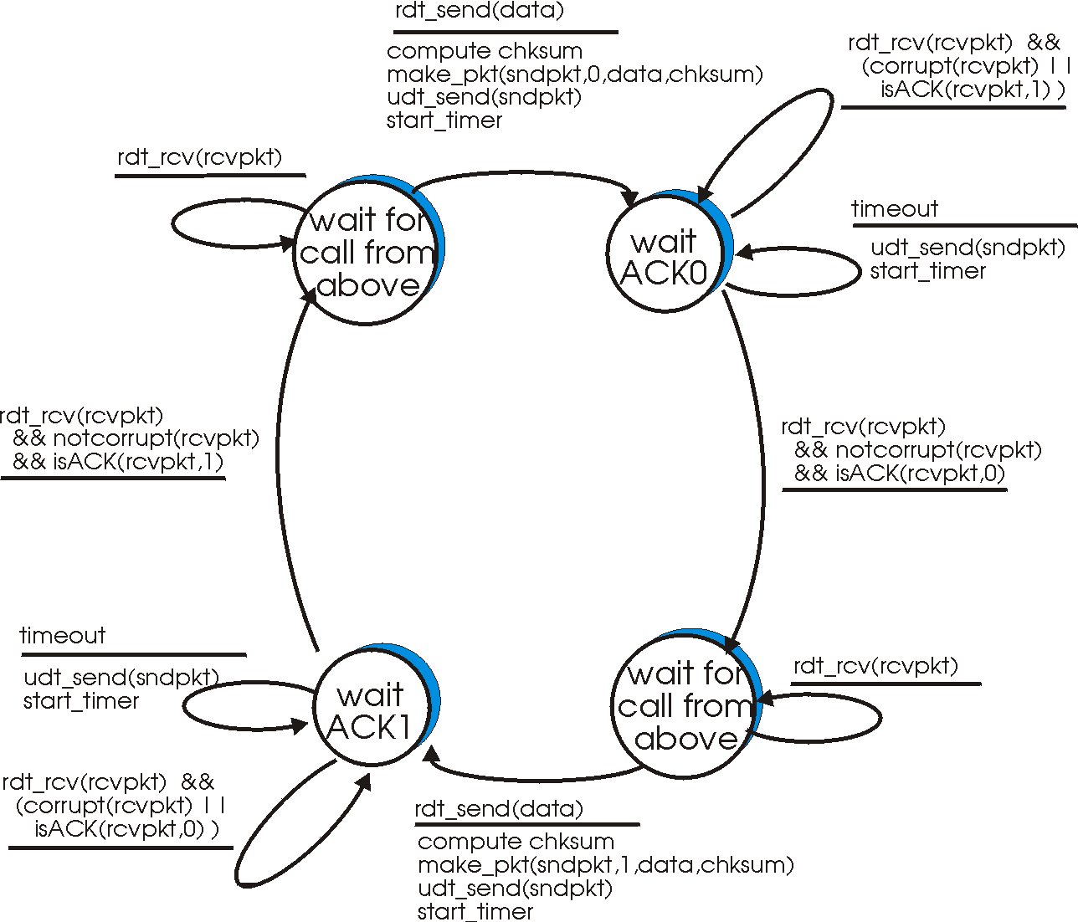
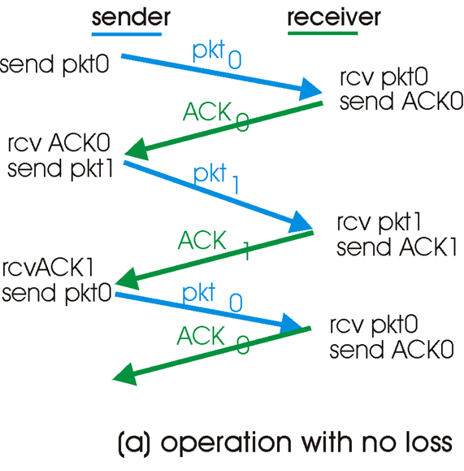
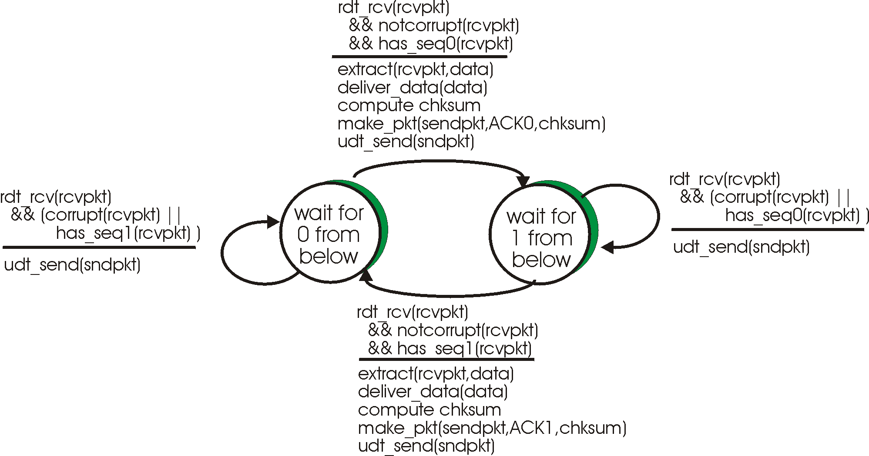
sender
receiver

Slide 30
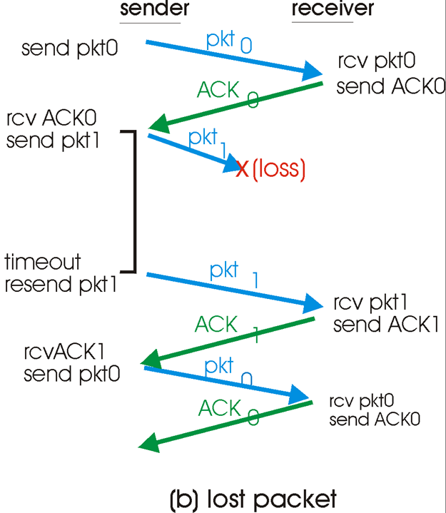
sender
receiver

Slide 31
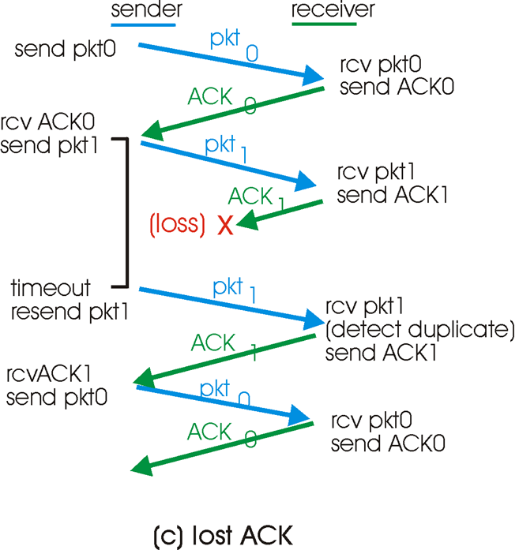
sender
receiver

Slide 32
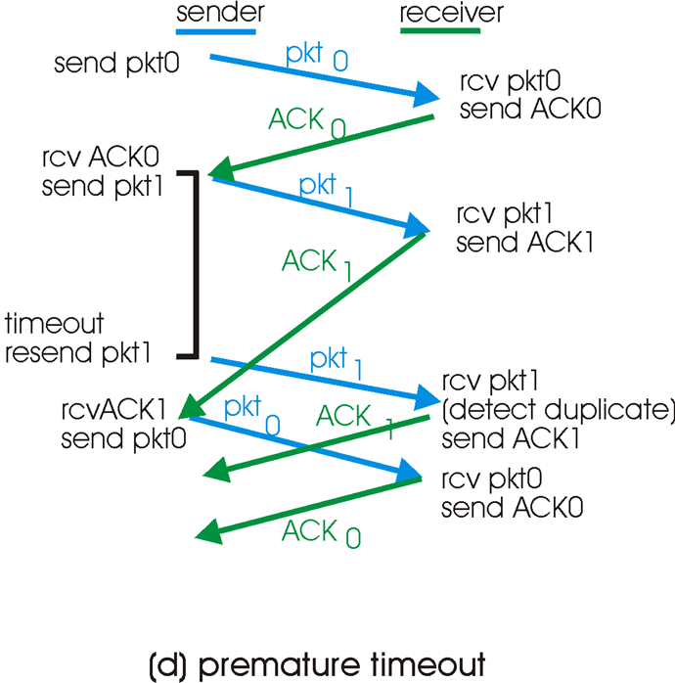
sender
receiver

Slide 33
End of Session

Slide 34
Performance of rdt3.0
rdt3.0 works, but performance is not acceptable
example: 1 Gbps link, 15 ms end-to-end propagation delay, 1KByte packet (1KByte = 8Kbit)
Utilization of sender (time busy sending)
T
8kb/pkt
transmit
=
= 8 microsec
10**9 b/sec
fraction of time
sender busy sending
0.008 msec
Utilization = U =
=
= 0.000267
30.008 msec
  1KByte of packet every 30 msec -> 267 kb/sec throughput over 1 Gbps link
  network protocol limits use of physical resources!
Notes:
Throughput-average rate of successful message delivery over a communication channel.

Slide 35

Pipelined protocols
Pipelining: sender allows multiple, “in-flight”, yet-to-be-acknowledged packets
  range of sequence numbers must be defined
  buffering at sender and/or receiver
Two generic forms of pipelined protocols:
Go-Back-N and Selective Repeat

Slide 36

Go-Back-N
Sender is allowed to transmit up to N unACKed packets
Uses a window of size N = value that limits the number of outstanding unACKed packets – for Flow control
Keeps track of the different sub-intervals in the range of SEQ numbers using: N, base and nextseqnum.
Sender:
base
Sequence Number Space
Defined in packet header, with k-bit sequence #
nextseqnum
nextseqnum
nextseqnum
nextseqnum
nextseqnum
nextseqnum
nextseqnum
nextseqnum

Slide 37
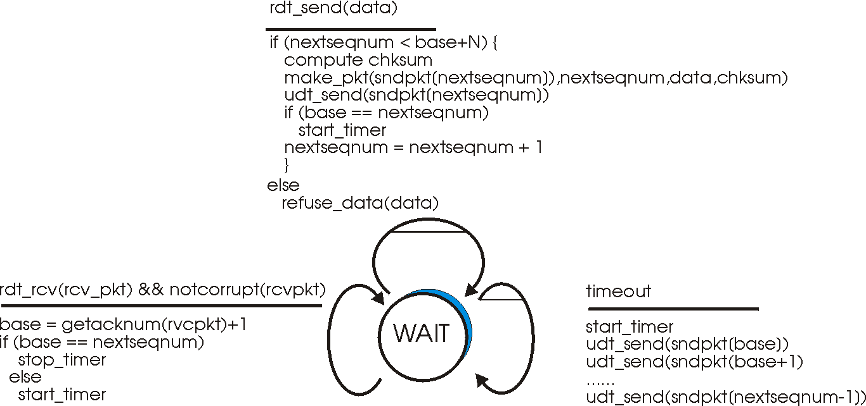
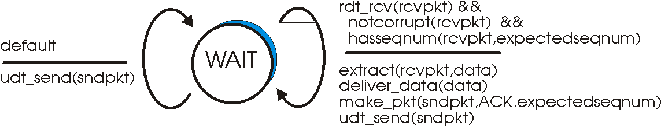
Go-Back-N: Sender
Sender:
Receiver:
expectedseqnum++
Sample Run
base
0 1 2 3 4 5 6 7 8 9 10 11 12 13 14 15 16 17 18 19 20 21 22 23 24
Initially, base=nextseqnum=8
nextseqnum
N=16,
base+N =8+16=24
Start timer
nextseqnum
nextseqnum
nextseqnum
nextseqnum
nextseqnum
nextseqnum
nextseqnum

Slide 38
Go-Back-N: Sender
Sender must respond to:
Cumulative ACKs:
  - ACK(n): ACKs all pkts up to, including seq # n - “cumulative ACK”
  - may receive duplicate ACKs (see receiver)
Rdt_send():
  - Before a packet is sent, the Window is checked first if its full; variables: base, nextseqnum and N
Timeout Event:
  -Timeout(n): retransmit pkt n and all higher seq # pkts in window
  - Only 1 timer is used: for the oldest transmitted but not yet ACKed packet

Slide 39
Go-Back-N: Extended FSM for the Sender
rdt_rcv(rcvpkt) && corrupt(rcvpkt)

Slide 40
Go-Back-N: Extended FSM for the Receiver
expectedseqnum++
Receiver:
Respond by ACK-only: always send ACK for correctly-received pkt with highest in-order seq #
  may generate duplicate ACKs
  need only remember expectedseqnum
Discards out-of-order pkts
  no receiver buffering!
  ACK pkt with highest in-order seq #

Slide 41

Go-Back-N in action
N=4
Expected sequence num=2

Slide 42
Selective Repeat
Receiver: individually acknowledges all correctly received pkts
  buffers pkts, as needed, for eventual in-order delivery to upper layer
Sender: only resends pkts for which ACK was not received
  one timer for each unACKed pkt
Sender Window:
  N consecutive Seq #’s
  again limits seq #s of sent, unACKed pkts

Slide 43

Selective Repeat: sender, receiver windows

Slide 44
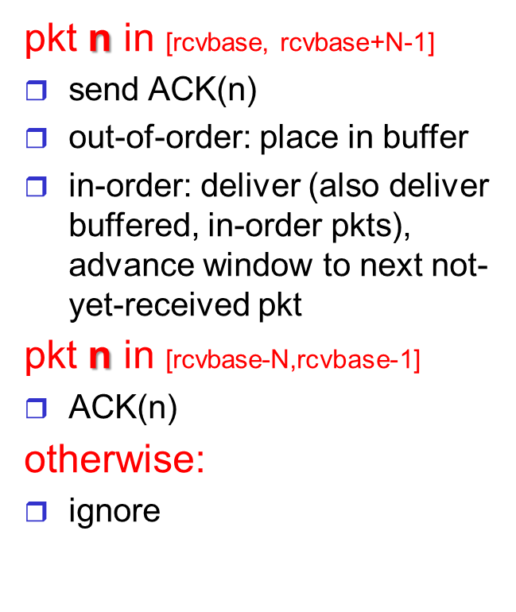
Selective Repeat
sender
receiver
data from above :
Send pkt if seq # is within the sender’s window; otherwise, it is buffered or returned to app. process
timeout(n):
resend only a single pkt n, then, restart timer
ACK(n) in [sendbase, sendbase+N-1]:
mark pkt n as received
if n smallest unACKed pkt, advance window base to next unACKed seq #

Slide 45
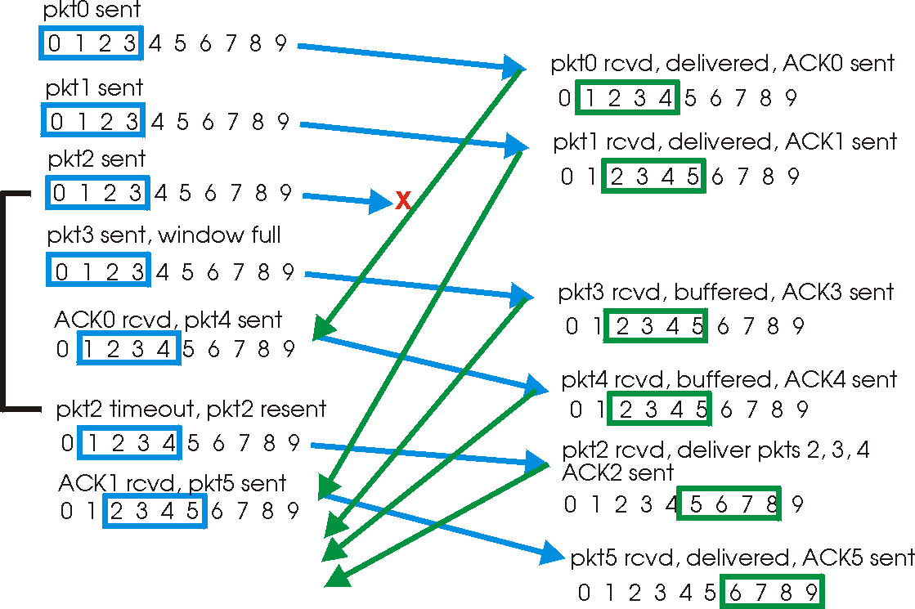
Selective repeat in action
Corrections needed for this slide!

Slide 46
Selective repeat in action
x
ACK1 rcvd, pkt5 sent
0 1 2 3 4 5 6 7 8 9
Pkt5 rcvd, buffered, ACK5 sent 0 1 2 3 4 5 6 7 8 9
Pkt2 TIMEOUT,
pkt2 resent
0 1 2 3 4 5 6 7 8 9
Pkt2 rcvd, pkt2,pkt3,pkt4,pkt5 delivered, ACK2 sent
0 1 2 3 4 5 6 7 8 9
ACK3 rcvd,
nothing sent
0 1 2 3 4 5 6 7 8 9

Slide 47


Selective repeat dilemma: retransmission or new packet?
Example:
seq #’s: 0, 1, 2, 3
window size=3
receiver sees no difference between two scenarios!
incorrectly passes duplicate data as new in (Fig. a)
Q: what relationship between seq # size and window size?
A window size= (size of Seq # Space-1) won’t work
Figurative Curtain

Slide 48

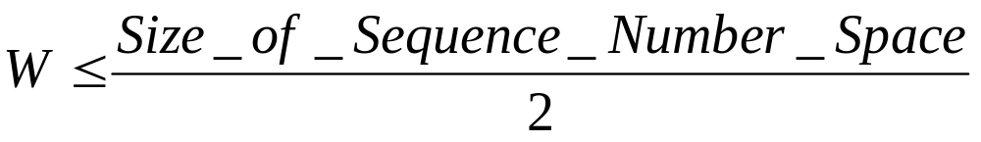
Selective repeat: dilemma
Setting the Window Size
To account for possible packet duplication due to
SEQ # assigning, packets are not allowed to “live” more than 3 min. (TCP Extensions for high speed networks) in the network.

